Slide 1
Contractor Performance Assessment Reporting System (CPARS) &
Past Performance Information Retrieval System (PPIRS)
Presented by Doreen F. Powell
Naval Sea Logistics Center, Portsmouth

Slide 2
Agenda
Past Performance Process Overview
What Areas of Performance Are Rated?
What Does an Evaluation Consist Of?
Best Practices for Submitting a Quality Evaluation
Upcoming Improvements
Resources
CPARS & PPIRS Help Desk

Slide 3


Past Performance Process Overview
Government Contracting & Program Officials
Government Source Selection Officials
CPARS
PPIRS
Contractor Representative
Contractor Senior Management

Slide 4
What Areas of Performance Are Rated?
Quality
  Product Performance Relative to Contract’s Performance Parameters
  Performance in Terms of Contract’s Quality Objectives
  Use Quantitative Indicators Wherever Possible
  Contractor’s Management of the Quality Control Program
  Quality of the Work or Service

Slide 5

What Areas of Performance Are Rated?
Schedule
  Timeliness of Delivery
  Timely Completion of Contract/Order
  Milestones
  Timely Completion of Administrative Requirements

Slide 6

What Areas of Performance Are Rated?
Cost Control
  Forecasting Cost
  Managing Cost
  Controlling Cost
  Overrun?
  Underrun?
  Not Required for Fixed Price Contracts/Orders

Slide 7
What Areas of Performance Are Rated?
Management
  Integration and Coordination of Activity
  Problem Identification
  Corrective Action Plans
  Reasonable and Cooperative Behavior
  Customer Satisfaction
  Subcontract Management
  Program Management
  Management of Key Personnel

Slide 8
What Areas of Performance Are Rated?
Utilization of Small Business
  Compliance with Terms and Conditions for Small Business Participation
  Achievement of Small Business Subcontracting Goals
  Good Faith Effort to Meet Small Business Subcontracting Goals

Slide 9
What Areas of Performance Are Rated?
Regulatory Compliance
  Compliance with Regulations and Codes
  Financial
  Environmental
  Labor
  Safety
  Reporting Requirements

Slide 10

What Does an Evaluation Consist Of?
Administrative Information
  Contractor Identification Information
  Dollars
  Dates
  Subcontractors
Contract Effort Description

Slide 11

What Does an Evaluation Consist Of?
Ratings
  Grading Scale Defined in Federal CPARS Guidance Document
Assessing Official Narrative
  Required for Each Area Evaluated
  Provides Detail to Support Rating Given

Slide 12

What Does an Evaluation Consist Of?
Contractor Comments
  Response to Government’s Evaluation
  Indicates if “Concur” or “Do Not Concur”
Reviewing Official Comments
  Resolves Disputes
  Only Required When Contractor Does Not Concur With Evaluation

Slide 13

Best Practices for Submitting a Quality Evaluation
Ratings & Narrative Consistent with Rating Definitions in Federal CPARS Guidance Document
Supported by Objective Evidence
  Status, Progress, Production, Management Reviews
  Earned Value Management Data
  Cost & Schedule Metrics
  Technical Reviews
  Quality Assurance Evaluations
  Earned Contract Incentives & Award Fee Determinations
  Subcontract Reports
  Safety & Labor Standard Compliance

Slide 14

Best Practices for Submitting a Quality Evaluation
Address Benefit & Impact of Contractor’s Performance to Government
Detail Contractor’s Strengths & Weaknesses
Address Government’s Role in Contractor’s Inability to Meet Requirements (if applicable)
Document Problems & Solutions
Contain Objective & Non-Personal Statements

Slide 15
Upcoming Improvements
CPARS Merge
  Consolidating Architect-Engineer Contract Administration Support System (ACASS) & Construction Contractor Appraisal Support System (CCASS) Modules Into Overall CPARS Application
  Single Evaluation Form
  Single Workflow Process
Coming July 1, 2014

Slide 16

Upcoming Improvements
Improved PPIRS Metrics Display
  Better Search & Display Capabilities for More Efficient Access to Relevant Reports
PPIRS Ad Hoc Reports
  Ability for Source Selection Officials to Tailor Reports to Best Meet Their Needs
Coming December 2014

Slide 17

Resources
CPARS Website: https://www.cpars.gov
  Training Link
    Online Training
    Automated Training
    On-Site Training
  Guidance Link
    Federal CPARS Guidance Document
    CPARS User Manual
    Office of Federal Procurement Policy (OFPP) Memos

Slide 18
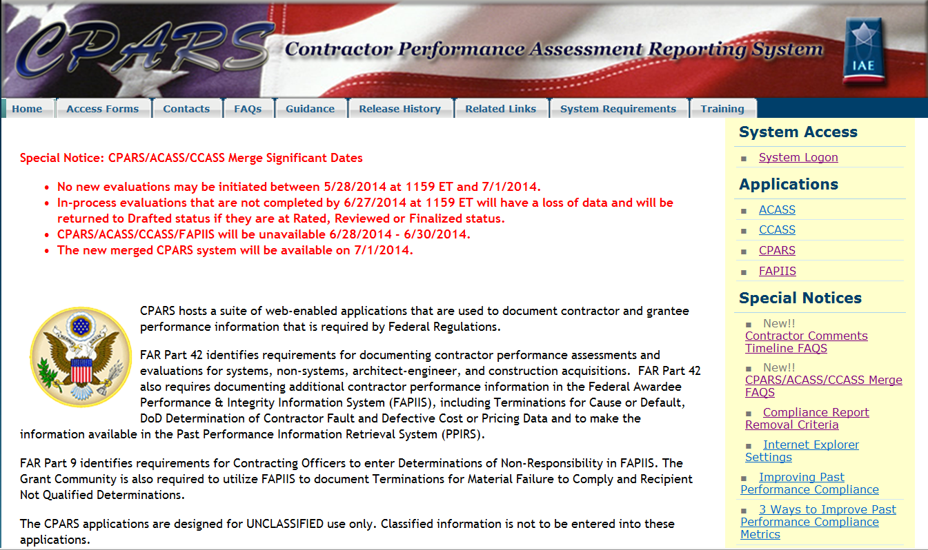
CPARS Home Page https://www.cpars.gov
Guidance
Training

Slide 19
Resources
PPIRS Website: https://www.ppirs.gov
  Training Link
    Online Training
  Reference Link
    User Manuals
    Compliance Report Information
  Guidance Link
    OFPP Memo

Slide 20
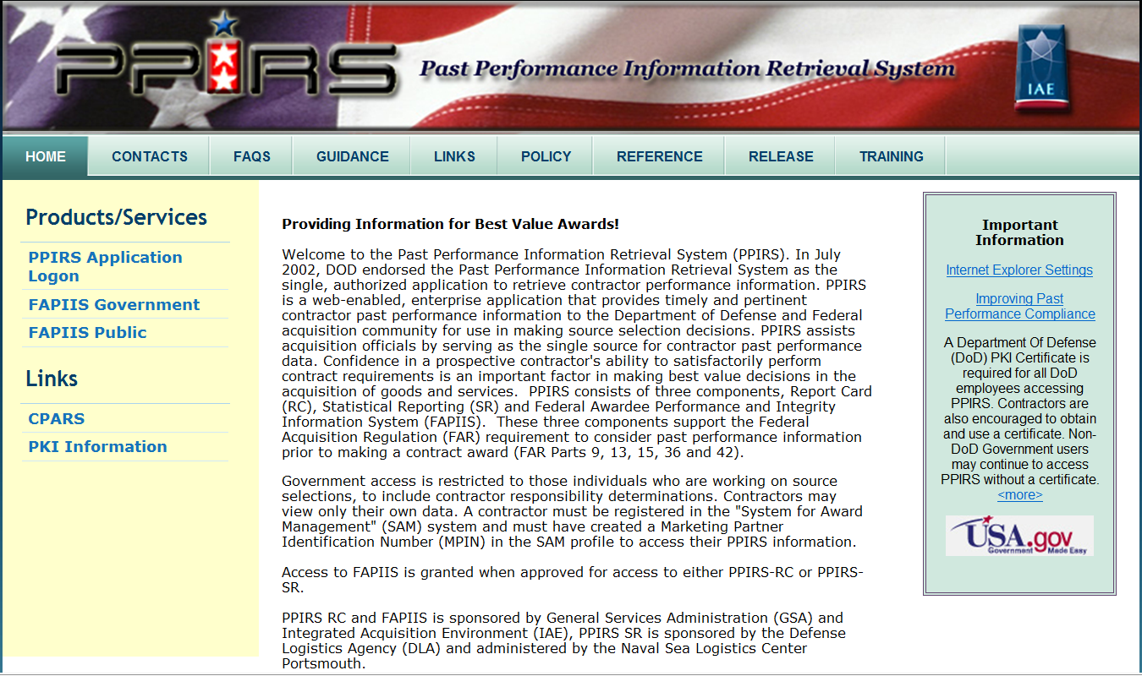
PPIRS Home Page https://www.ppirs.gov
Guidance
Reference
Training

Slide 21
CPARS & PPIRS Help Desk
Phone: 207-438-1690
  DSN: 684-1690
Email: webptsmh@navy.mil
Help is available Monday – Friday,
6:30 am – 6:00 pm ET.

